Slide 1
Search Techniques in AI
Rupa Mehta
COED, SVNIT, Surat

Slide 2
Search in Artificial Intelligence
Search plays a major role in solving many AI problems.
Search is a universal problem-solving mechanism in AI.
  In many problems, sequence of steps required to solve is not known in advance but must be determined by systematic trial-and-error exploration of alternatives.
The problems that are addressed by AI search algorithms fall into three general classes:
  single-agent path-finding problems,
  two-players games, and
  constraint-satisfaction problems

Slide 3
Single-agent path-finding problems
  The task is to find a sequence of operations that map an initial state to a goal state.
Classic examples in the AI literature of path-finding problems are
  sliding-title puzzles,
  Rubik’s Cube and
  theorem proving.
The single-title puzzles are commonly discussed by AI researchers due to their simplicity and easy manipulation.
Other Real-world problems:
  traveling salesman problem, vehicle navigation, and the wiring of VLSI circuits

Slide 4
Two-players games
Two-players games are two-player perfect information games.
E.g. Chess, checkers, othello

Slide 5
Search
Given a problem expressed as a state space (whether explicitly or implicitly)
  with operators/actions, an initial state and a goal state, how do we find the sequence of operators needed to solve the problem?
  this requires search
Formally, we define a search space as [N, A, S, GD]
  N = set of nodes or states of a grapsh
  A = set of arcs (edges) between nodes that correspond to the steps in the problem (the legal actions or operators)
  S = a nonempty subset of N that represents start states
  GD = a nonempty subset of N that represents goal states
Our problem becomes one of traversing the graph from a node in S to a node in GD
  we can use any of the numerous graph traversal techniques for this but in general, they divide into two categories:
    brute force – unguided search
    heuristic – guided search

Slide 6
Problem Space
Problem space is a set of states and the connections between initial state to the goal state
Problem space graph is used to represent a problem space.
  In the graph, the states are represented by nodes of the graph, and the operators by edges between nodes.
  Although most problem spaces correspond to graphs with more than one path between a pair of nodes, for simplicity they are often represented as trees, where the initial state is the root of the tree.
  The cost of the simplification is that any state that can be reached by two different paths will be represented by duplicate nodes thereby increasing the tree size.
  The benefit of using tree is that the absence of cycles greatly simplifies many search algorithms.

Slide 7
Problem Space (Cont..)
One feature that distinguishes AI search algorithms from other graph-searching algorithms is the size of the graph involved. E.g.
  The entire chess graph is estimated to contain over 10^40 nodes.
  Even a simple problem like twenty-four puzzle contains almost 10^25 nodes.
  As a result, the problem-space graphs of AI problems are never represented explicitly by listing each state, but rather are implicitly represented by specifying an initial state and a set of operators to generate new states from existing states.

Slide 8
Problem Space (Cont..)
  The size of an AI problem are not defined as the number of nodes in its problem-space graph.
  The two parameters of a search tree that determine the efficiency of various search algorithms are
    branching factor : Average number of children of a given node. For example in eight-puzzle problem, the average branching factor is square-root(3) or about 1.732.
    its solution depth.: The length of a shortest path from the initial state to a goal state or the length of a shortest sequence of operators that solve the problem.

Slide 9
Different approaches
Brute-Force Approach
Heuristic Search
Two-Player-Games Search
Interleaving Search

Slide 10
Brute-Force Approach
The most general search algorithms
Do not require any domain specific knowledge.
Require a state description, a set of legal operators, an initial state, and a descriptions of the goal state.
Also called uninformed search and blind search.
Brute-force search should proceed in a systematic way by exploring nodes in some predetermined order or simply by selecting nodes at random.
Search programs either return only a solution value when a goal is found or record and return the solution path. The most important brute-force techniques are as below.

Slide 11
Search strategies
A search strategy is defined by picking the order of node expansion
Strategies are evaluated along the following dimensions:
  completeness: does it always find a solution if one exists?
  time complexity: number of nodes generated
  space complexity: maximum number of nodes in memory
  optimality: does it always find a least-cost solution?
Time and space complexity are measured in terms of
  b: maximum branching factor of the search tree
  d: depth of the least-cost solution
  m: maximum depth of the state space (may be ∞)

Slide 12
The most important brute-force techniques
Generate-And-Test
Breadth-First Search
Uniform-Cost Search
Depth-First Search
Depth-First Iterative-Deepening Search
Bidirectional Search
Combinatorial Explosion
AI Search Techniques

Slide 13
Generate-And-Test Algorithm
very simple algorithm
guarantees to find a solution if done systematically and there exists a solution.
Algorithm: Generate-And-Test
  Generate a possible solution.
  Test to see if this is the expected solution.
  If the solution has been found quit else go to step 1.
Potential solutions that need to be generated vary depending on the kinds of problems.
  For some problems the possible solutions may be particular points in the problem space
  For some problems, paths from the start state.

Slide 14
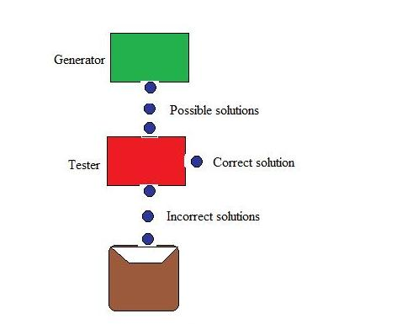
Generate-And-Test Algorithm (cont….)

Slide 15
Generate-And-Test Algorithm (cont….)
Generate-and-test, like depth-first search, requires that complete solutions be generated for testing.
In its most systematic form, it is only an exhaustive search of the problem space.
Solutions can also be generated randomly but solution is not guaranteed.
  This approach is what is known as British Museum algorithm: finding an object in the British Museum by wandering randomly.

Slide 16
Systematic Generate-And-Test
Two extreme approaches for G&T
  generating complete solutions
  generating random solutions
The intermediate approach
  The search process proceeds systematically but some paths that unlikely to lead the solution are not considered.
  This evaluation is performed by a heuristic function.
  E.g. Depth-first search tree with backtracking : if some intermediate states are likely to appear often in the tree, it would be better to modify that procedure to traverse a graph rather than a tree.

Slide 17
Generate-And-Test And Planning
Exhaustive generate-and-test is very useful for simple problems.
For complex problems even heuristic generate-and-test is not very effective technique.
For more efficient results there is a need to restrict the search fot the it should be Combined with other techniques
  E.g. An AI program DENDRAL used plan-Generate-and-test technique.
  First the planning process uses constraint-satisfaction techniques and creates lists of recommended and contraindicated substructures.Then the G&T procedure uses the lists generated and required to explore only a limited set of structures.
  Major weakness : It often produces inaccurate solutions as there is no feedback from the world.
  If it is used to produce only pieces of solutions then lack of detailed accuracy becomes unimportant.

Slide 18
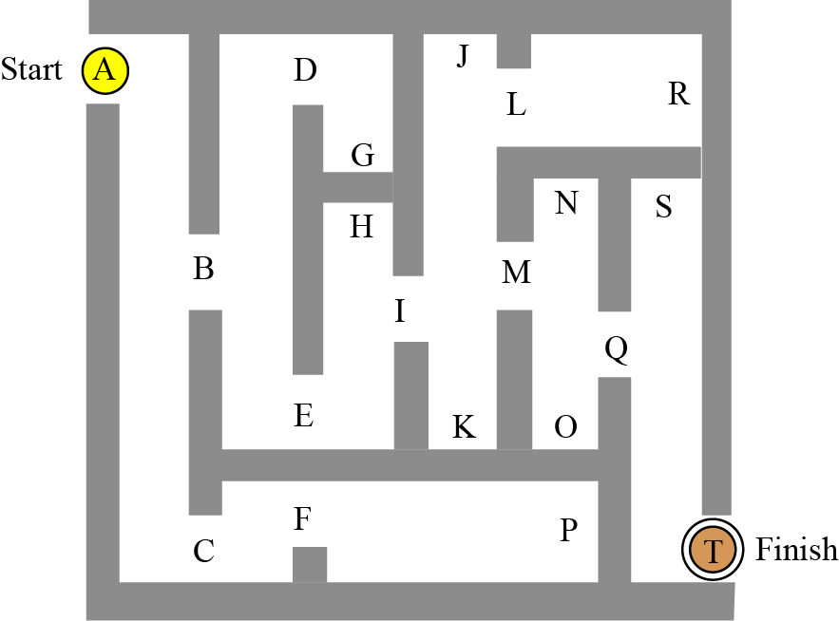
Example : The Maze Problem
Consider the steps required to find our way through the maze in Figure with points A : Starting Point and T : finishing point

Slide 19
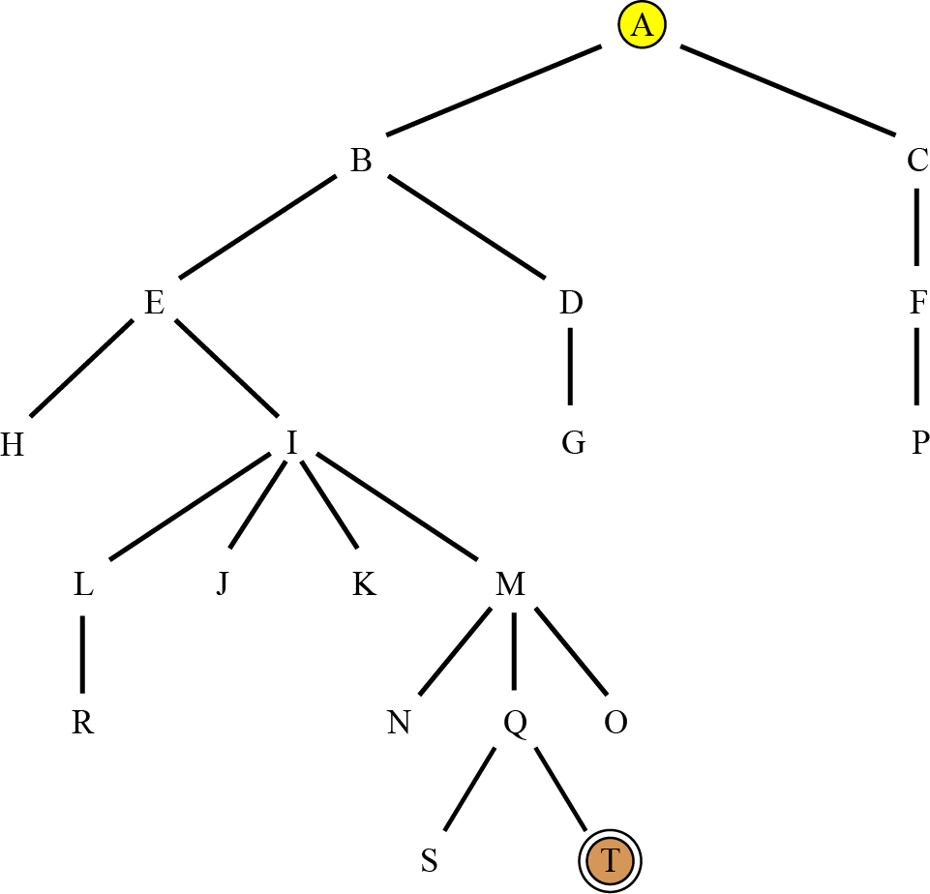
The tree for the maze

Slide 20
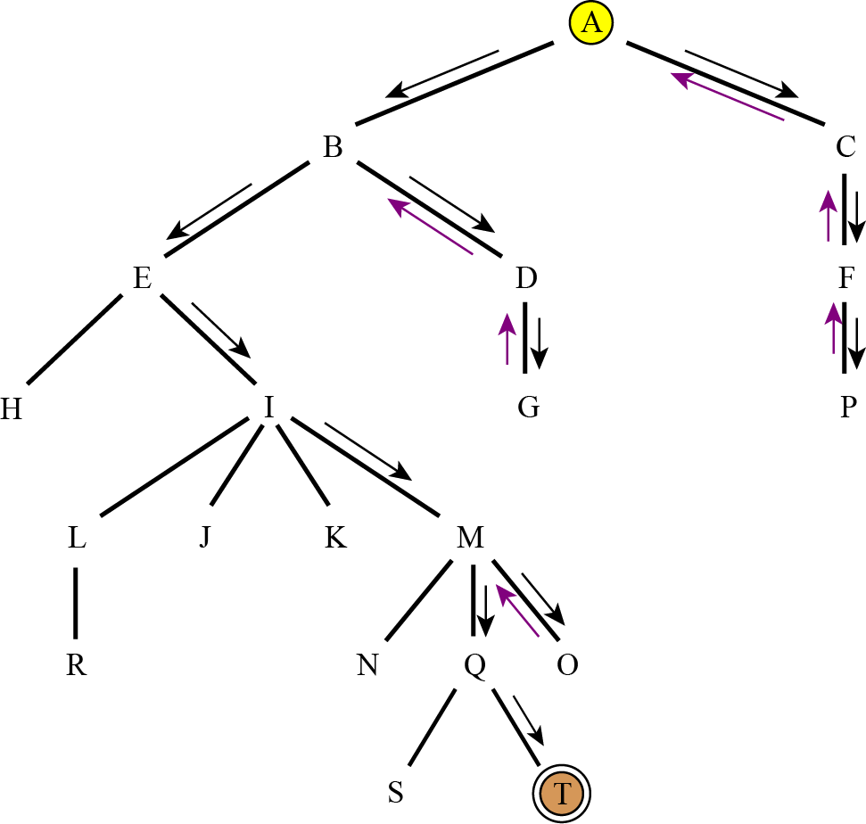
Depth-first search of the tree

Slide 21
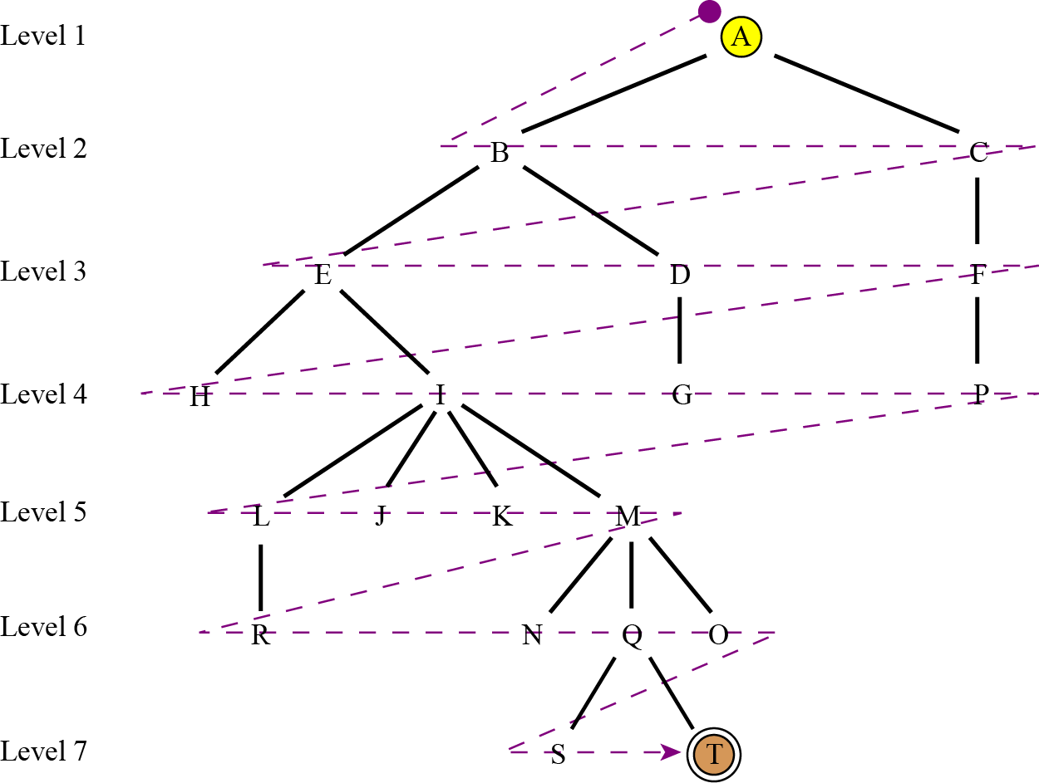
Breadth-first search of the tree

Slide 22
Breadth First Search (BFS)
It searches breadth-wise in the problem space.
It is like traversing a tree where each node is a state which may a be a potential candidate for solution.
It expands nodes from the root of the tree and then generates one level of the tree at a time until a solution is found.
It is very easily implemented by maintaining a queue of nodes. Initially the queue contains just the root. In each iteration, node at the head of the queue is removed and then expanded. The generated child nodes are then added to the tail of the queue.

Slide 23
Algorithm: Breadth-First Search
Create a variable called NODE-LIST and set it to the initial state.
Loop until the goal state is found or NODE-LIST is empty.
  Remove the first element, say E, from the NODE-LIST. If NODE-LIST was empty then quit.
  For each way that each rule can match the state described in E do:
Apply the rule to generate a new state.
If the new state is the goal state, quit and return this state.
Otherwise add this state to the end of NODE-LIST

Slide 24

Breadth-first search
Expand shallowest unexpanded node
Fringe: nodes waiting in a queue to be explored
Implementation:
  fringe is a first-in-first-out (FIFO) queue, i.e., new successors go at end of the queue.
Is A a goal state?

Slide 25

Breadth-first search
Expand shallowest unexpanded node
Implementation:
  fringe is a FIFO queue, i.e., new successors go at end
Expand:
fringe = [B,C]
Is B a goal state?

Slide 26

Breadth-first search
Expand shallowest unexpanded node
Implementation:
  fringe is a FIFO queue, i.e., new successors go at end
Expand:
fringe=[C,D,E]
Is C a goal state?

Slide 27

Breadth-first search
Expand shallowest unexpanded node
Implementation:
  fringe is a FIFO queue, i.e., new successors go at end
Expand:
fringe=[D,E,F,G]
Is D a goal state?

Slide 28
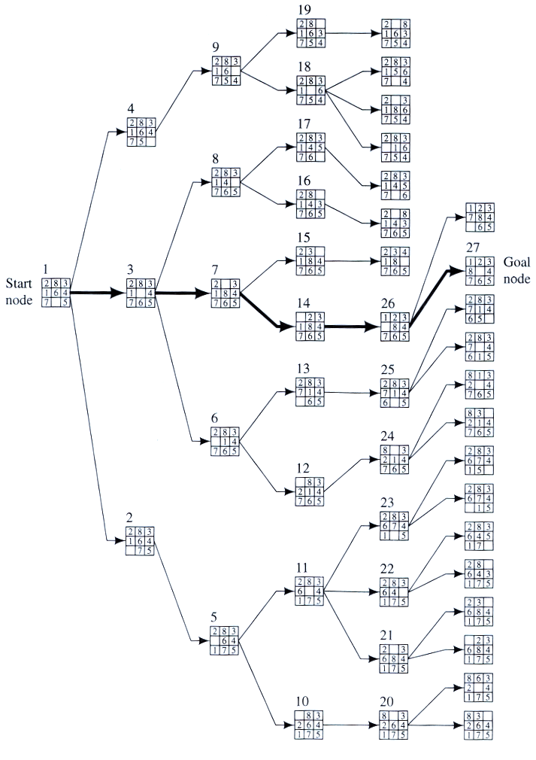
Example
BFS

Slide 29
Properties of breadth-first search
Complete? Yes it always reaches goal (if b is finite)
Time? 1+b+b²+b³+… +b^{d} + (b^{d+1}-b)) = O(b^{d+1})
(this is the number of nodes we generate)
Space? O(b^{d+1}) (keeps every node in memory,
either in fringe or on a path to fringe).
Optimal? Yes (if we guarantee that deeper solutions are less optimal, e.g. step-cost=1).
Space is the bigger problem (more than time)

Slide 30
Breadth-First Search (cont..)
Since it never generates a node in the tree until all the nodes at shallower levels have been generated, breadth-first search always finds a shortest path to a goal.
Since each node can be generated in constant time, the amount of time used by Breadth first search is proportional to the number of nodes generated, which is a function of the branching factor b and the solution d.
Since the number of nodes at level d is b^{d}, the total number of nodes generated in the worst case is b + b² + b³ +… + b^{d} i.e. O(b^{d}) , the asymptotic time complexity of breadth first search.

Slide 31
Pros and Cons of Breadth-First Search
Advantages of BFS
It will never get trapped exploring the useless path forever.
  If there is a solution, BFS will definitely find it out.
  If there is more than one solution then BFS can find the minimal one that requires less number of steps.
Disadvantages of BFS
The main drawback is its memory requirement.
  Since each level of the tree must be saved in order to generate the next level, and the amount of memory is proportional to the number of nodes stored, the space complexity of BFS is O(b^{d}).
  As a result, BFS is severely space-bound in practice so will exhaust the memory available on typical computers in a matter of minutes.
  If the solution is farther away from the root, breath first search will consume lot of time.

Slide 32
Uniform-Cost Search Algorithm
If all the edges in the search graph do not have the same cost then BFS is generalizes to uniform-cost search.
Instead of expanding nodes in order of their depth from the root, UCS expands nodes in order of their cost from the root.
  At each step, the next step n to be expanded is one whose cost g(n) is lowest where g(n) is the sum of the edge costs from the root to node n. The nodes are stored in a priority queue. This algorithm is also known as Dijkstra’s single-source shortest algorithm.
Whenever a node is chosen for expansion by UCS, a lowest-cost path to that node has been found.
The worst case time complexity of UCS : O(b^{c/m}),
  where c is the cost of an optimal solution and m is the minimum edge cost.
  Unfortunately, it also suggests the same memory limitation as BFS.

Slide 33
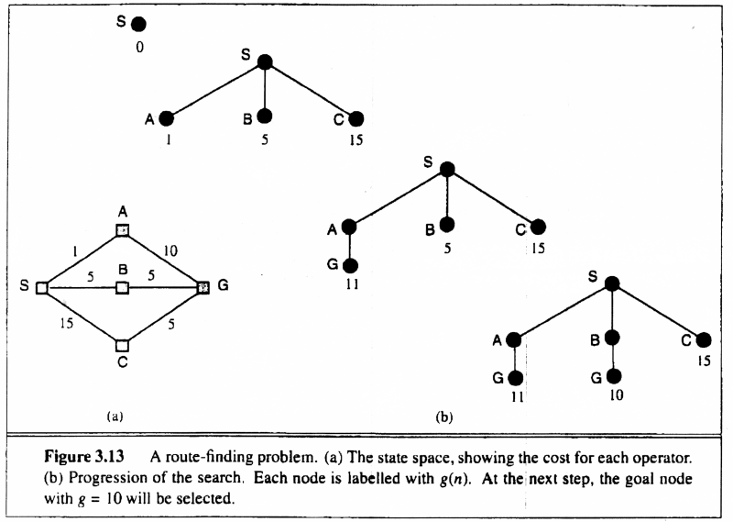
Uniform-cost search
Breadth-first is only optimal if step costs is increasing with depth (e.g. constant). Can we guarantee optimality for any step cost?
Uniform-cost Search: Expand node with
smallest path cost g(n).
Proof Completeness:
Given that every step will cost more than 0,
and assuming a finite branching factor, there
is a finite number of expansions required before
the total path cost is equal to the path cost of the
goal state. Hence, we will reach it.
Proof of optimality given completeness:
Assume UCS is not optimal.
Then there must be a goal state with path cost
smaller than the goal state which was found
(invoking completeness).
However, this is impossible because UCS would
have expanded that node first by definition.
Contradiction.

Slide 34
Uniform Cost Search
used for traversing a weighted tree or graph.
different cost of each edge.
Goal : to find a path to the goal node which has the lowest cumulative cost.
expands nodes according to their path costs form the root node.
Aim: optimal cost
Fringe : priority queue with maximum priority to the lowest cumulative cost.
equivalent to BFS algorithm if the path cost of all edges is the same.
Advantages: optimal search as at every state the lowest cost path is chosen.
Disadvantages: as only concerned about path cost may result in infinite loop.

Slide 35
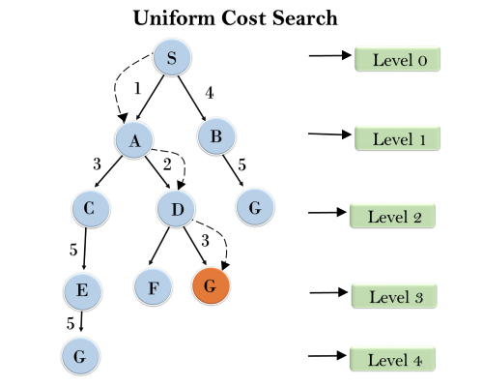
Uniform Cost Search

Slide 36
Uniform-cost search
Implementation: fringe = queue ordered by path cost
Equivalent to breadth-first if all step costs all equal.
Complete? Yes, if step cost ≥ ε
(otherwise it can get stuck in infinite loops)
Time? # of nodes with path cost ≤ cost of optimal solution.
Space? # of nodes on paths with path cost ≤ cost of optimal
solution.
Optimal? Yes, for any step cost ≥ ε

Slide 37
straight-line distances
A
6
D
1
F
3
1
h(S-G)=10
h(A-G)=7
h(D-G)=1
h(F-G)=1
h(B-G)=10
h(E-G)=8
h(C-G)=20
S
2
4
8
G
B
E
1
20
C
The graph above shows the step-costs for different paths going from the start (S) to
the goal (G). On the right you find the straight-line distances.
Use uniform cost search to find the optimal path to the goal.
Exercise for at home

Slide 38
Depth First Search Algorithm
Depth First Search (DFS) searches deeper into the problem space.
DFS uses last-in first-out stack for keeping the unexpanded nodes (stack).
Algorithm: Depth First Search
If the initial state is a goal state, quit and return success.
Otherwise, loop until success or failure is signaled.
  Generate a state, say E, and let it be the successor of the initial state. If there is no successor, signal failure.
  Call Depth-First Search with E as the initial state.
  If success is returned, signal success. Otherwise continue in this loop.

Slide 39

Depth-first search
Expand deepest unexpanded node
Implementation:
  fringe = Last In First Out (LIPO) queue, i.e., put successors at front
Is A a goal state?

Slide 40

Depth-first search
Expand deepest unexpanded node
Implementation:
  fringe = LIFO queue, i.e., put successors at front
queue=[B,C]
Is B a goal state?

Slide 41

Depth-first search
Expand deepest unexpanded node
Implementation:
  fringe = LIFO queue, i.e., put successors at front
queue=[D,E,C]
Is D = goal state?

Slide 42

Depth-first search
Expand deepest unexpanded node
Implementation:
  fringe = LIFO queue, i.e., put successors at front
queue=[H,I,E,C]
Is H = goal state?

Slide 43

Depth-first search
Expand deepest unexpanded node
Implementation:
  fringe = LIFO queue, i.e., put successors at front
queue=[I,E,C]
Is I = goal state?

Slide 44

Depth-first search
Expand deepest unexpanded node
Implementation:
  fringe = LIFO queue, i.e., put successors at front
queue=[E,C]
Is E = goal state?

Slide 45

Depth-first search
Expand deepest unexpanded node
Implementation:
  fringe = LIFO queue, i.e., put successors at front
queue=[J,K,C]
Is J = goal state?

Slide 46

Depth-first search
Expand deepest unexpanded node
Implementation:
  fringe = LIFO queue, i.e., put successors at front
queue=[K,C]
Is K = goal state?

Slide 47

Depth-first search
Expand deepest unexpanded node
Implementation:
  fringe = LIFO queue, i.e., put successors at front
queue=[C]
Is C = goal state?

Slide 48

Depth-first search
Expand deepest unexpanded node
Implementation:
  fringe = LIFO queue, i.e., put successors at front
queue=[F,G]
Is F = goal state?

Slide 49

Depth-first search
Expand deepest unexpanded node
Implementation:
  fringe = LIFO queue, i.e., put successors at front
queue=[L,M,G]
Is L = goal state?

Slide 50

Depth-first search
Expand deepest unexpanded node
Implementation:
  fringe = LIFO queue, i.e., put successors at front
queue=[M,G]
Is M = goal state?

Slide 51
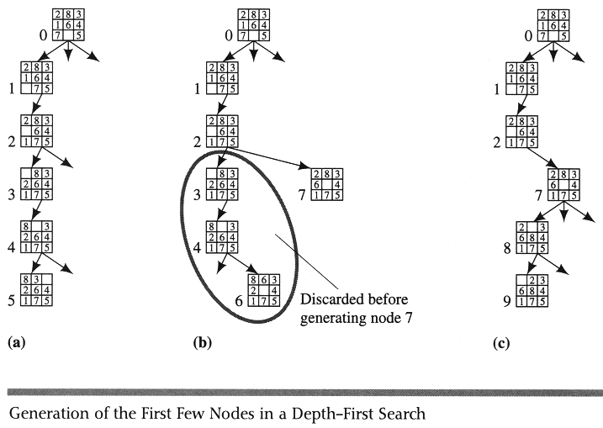
Example DFS

Slide 52
Properties of depth-first search
A
Complete? No: fails in infinite-depth spaces
Can modify to avoid repeated states along path
Time? O(b^{m}) with m=maximum depth
terrible if m is much larger than d
  but if solutions are dense, may be much faster than
  breadth-first
Space? O(bm), i.e., linear space! (we only need to
remember a single path + expanded unexplored nodes)
Optimal? No (It may find a non-optimal goal first)
B
C

Slide 53
Pros and Cons of DFS
Advantages of Depth-First Search
memory requirement is linear with respect to the search graph.
  Only needs memory to store a stack of nodes on the path from the root to the current node.
  The time complexity is O(b^d)
    As it generates the same set of nodes as BFS, but simply in a different order.
    Thus practically depth-first search is time-limited rather than space-limited.
If depth-first search finds solution without exploring much in a path then the time and space it takes will be very less.

Slide 54
Pros and Cons of DFS (cont…)
Disadvantages of Depth-First Search
There is a possibility that it may go down the left-most path forever.
  Even a finite graph can generate an infinite tree.
  One solution to this problem is to impose a cutoff depth on the search.
  Although the ideal cutoff is the solution depth d and this value is rarely known in advance of actually solving the problem.
  If the chosen cutoff depth is less than d, the algorithm will fail to find a solution, whereas if the cutoff depth is greater than d, a large price is paid in execution time, and the first solution found may not be an optimal one.
It is not guaranteed to find the solution.
And there is no guarantee to find a minimal solution, if more than one solution exists.

Slide 55
Some comments on DFS and BFS
In a graph with cycles, however, BFS may be much more efficient than any DFS.
  As a BFS can check for duplicate nodes whereas a DFS cannot.
  complexity of BFS grows only as the number of nodes at a given depth, while the complexity of DFS depends on the number of paths of a given length.
  E.g. in a square grid, the number of nodes within a radious r of the origin is O(r^2), whereas the number of paths of length r is O(3^r), since there are three children of every node, counting its parent.
  Thus, in a graph with a large number of very short cycles, breadth-first search is preferable to depth-first search, if sufficient memory is available.

Slide 56
Depth-First Iterative Deepening (DFID) Search
Depth-First Iterative Deepening (DFID) search combines the best features of BFS and DFS.
DFIDS first performs a DFS to depth one, then starts over, executing a complete DFS to depth two, and continues to run depth-first searches to successively greater depths, until a solution is found.
It never generates a node until all shallower nodes have been generated, the first solution found by DFIDS is guaranteed to be along a shortest path.
At any given point it is executing a DFS, saving only a stack of nodes, and the algorithm terminates when it finds a solution at depth d, the space complexity of DFIDS is only O(d).

Slide 57
Iterative deepening search
To avoid the infinite depth problem of DFS, we can
decide to only search until depth L, i.e. we don’t expand beyond depth L.
→ Depth-Limited Search
What of solution is deeper than L? → Increase L iteratively.
→ Iterative Deepening Search
As we shall see: this inherits the memory advantage of Depth-First
search, and is better in terms of time complexity than Breadth first search.

Slide 58

Iterative deepening search L=0

Slide 59

Iterative deepening search L=1

Slide 60

Iterative deepening search L=2

Slide 61

Iterative Deepening Search L=3

Slide 62

Iterative deepening search
Number of nodes generated in a depth-limited search to depth d with branching factor b:
N_{DLS} = b⁰ + b¹ + b² + … + b^{d-2} + b^{d-1} + b^{d}
Number of nodes generated in an iterative deepening search to depth d with branching factor b:
N_{IDS} = (d+1)b⁰ + d b¹ + (d-1)b² + … + 3b^{d-2} +2b^{d-1} + 1b^{d} =
For b = 10, d = 5,
  N_{DLS} = 1 + 10 + 100 + 1,000 + 10,000 + 100,000 = 111,111
  N_{IDS} = 6 + 50 + 400 + 3,000 + 20,000 + 100,000 = 123,450
  NBFS = ............................................................................................ = 1,111,100
BFS

Slide 63
Properties of iterative deepening search
Complete? Yes
Time? O(b^{d})
Space? O(bd)
Optimal? Yes, if step cost = 1 or increasing function of depth.

Slide 64
Bidirectional Search
Searches in two directions at the same time:
  one forward from the initial state
  Other backward from the goal.
  Eexpand tree with branching factor b and the distance from start to goal is d.
  The search stops when searches from both directions meet in the middle.
  Bidirectional search is a brute-force search algorithm that requires an explicit goal state instead of simply a test for a goal condition. Once the search is over, the path from the initial state is then concatenated with the inverse of the path from the goal state to form the complete solution path.

Slide 65
Bidirectional Search
Idea
  simultaneously search forward from S and backwards from G
  stop when both “meet in the middle”
  need to keep track of the intersection of 2 open sets of nodes
What does searching backwards from G mean
  need a way to specify the predecessors of G
    this can be difficult,
    e.g., predecessors of checkmate in chess?
  which to take if there are multiple goal states?
  where to start if there is only a goal test, no explicit list?

Slide 66
Bidirectional Search (Cont..)
It guarantees optimal solutions.
Assuring that the comparisons for identifying a common state between the two frontiers can be done in constant time per node by hashing.
The time complexity of Bidirectional Search is O(b^d/2) since each search need only proceed to half the solution path.
Since at least one of the searches must be breadth-first in order to find a common state, the space complexity of bidirectional search is also O(b^d/2).
As a result, it is space bound in practice.

Slide 67
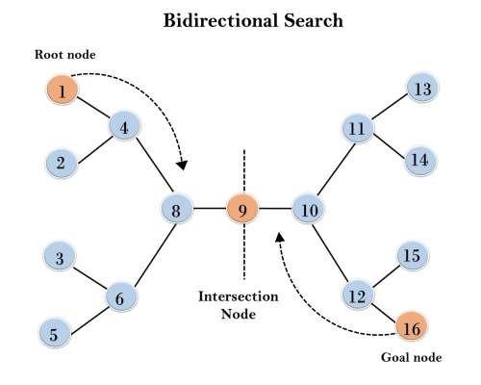
Example

Slide 68
Pros and Cons of Bidirectional Search
Advantages
The merit of bidirectional search is its speed. Sum of the time taken by two searches (forward and backward) is much less than the O(b^{d}) complexity.
It requires less memory.
Disadvantages
Implementation of bidirectional search algorithm is difficult because additional logic must be included to decide which search tree to extend at each step.
One should have known the goal state in advance.
The algorithm must be too efficient to find the intersection of the two search trees.
It is not always possible to search backward through possible states.

Slide 69
Combinatorial Explosion
The problem with all brute-force search algorithms is that their time complexities grow exponentially with problem size. This problem is called combinatorial explosion.
The combinatorial explosion results in limited size of problems that can be solved with brute-force search techniques.
  E.g. while eight-puzzle with 10⁵ states is easily solved by brute-force search,
  The fifteen-puzzle contains over 10¹³ states, and hence cannot be solved with brute-force techniques on current machines.
  Even faster machines cannot have significant impact on this problem since the 5 * 5 twenty-four puzzle contains almost 10²⁵ states.

Slide 70

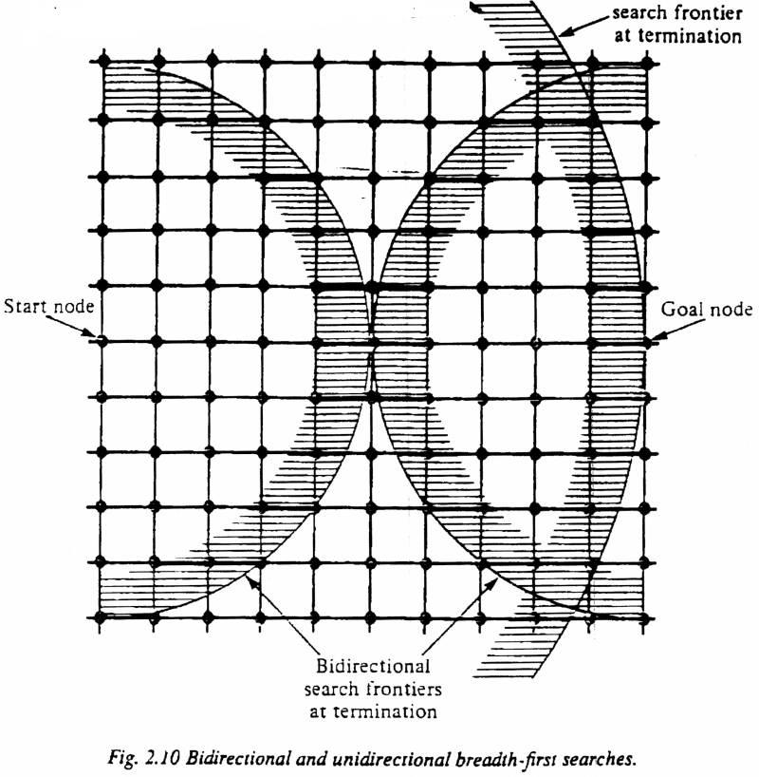
Bi-Directional Search
Complexity: time and space complexity are:

Slide 71

Summary of algorithms
even complete
if step cost is not
increasing with depth.
preferred
uninformed
search strategy

Slide 72

Repeated states
Failure to detect repeated states can turn a linear problem into an exponential one!

Slide 73
Solutions to Repeated States
S
B
S
B
C
C
C
S
B
S
State Space
Example of a Search Tree
Graph search
  never generate a state generated before
    must keep track of all possible states (uses a lot of memory)
    e.g., 8-puzzle problem, we have 9! = 362,880 states
    approximation for DFS/DLS: only avoid states in its (limited) memory: avoid looping paths.
    (this does not avoid the problem on the previous slide)
    Graph search optimal for BFS and UCS, not for DFS.
optimal but memory inefficient

Slide 74
Summary
Problem formulation usually requires abstracting away real-world details to define a state space that can feasibly be explored
Variety of uninformed search strategies
Iterative deepening search uses only linear space and not much more time than other uninformed algorithms
http://www.cs.rmit.edu.au/AI-Search/Product/
http://aima.cs.berkeley.edu/demos.html (for more demos)

Slide 75
Different approaches
Brute-Force Approach
Heuristic Search
Two-Player-Games Search
Interleaving Search

Slide 76

Examples

Slide 77
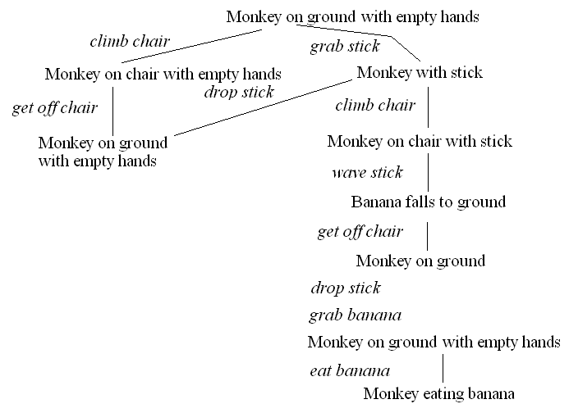
The Monkey & Bananas Problem
A monkey is in a cage and bananas are suspended from the ceiling, the monkey wants to eat a banana but cannot reach them
  in the room are a chair and a stick
  if the monkey stands on the chair and waves the stick, he can knock a banana down to eat it
  what are the actions the monkey should take?
Initial state:
monkey on ground
with empty hand
bananas suspended
Goal state:
monkey eating
Actions:
climb chair/get off
grab X
wave X
eat X

Slide 78
Missionaries and Cannibals
3 missionaries and 3 cannibals are on one side of the river with a boat that can take exactly 2 people across the river
  how can we move the 3 missionaries and 3 cannibals across the river
  with the constraint that the cannibals never outnumber the missionaries on either side of the river (lest the cannibals start eating the missionaries!)??
We can represent a state as a 6-item tuple:
  (a, b, c, d, e, f)
    a/b = number of missionaries/cannibals on left shore
    c/d = number of missionaries/cannibals in boat
    e/f = number of missionaries/cannibals on right shore
    where a + b + c + d + e + f = 6
    and a >= b unless a = 0, c >= d unless c = 0, and e >= f unless e = 0
Legal operations (moves) are
  0, 1, 2 missionaries get into boat (c + d must be <= 2)
  0, 1, 2 missionaries get out of boat
  0, 1, 2 cannibals get into boat (c + d must be <= 2)
  0, 1, 2 missionaries get out of boat
  boat sails from left shore to right shore (c + d must be >= 1)
  boat sails from right shore to left shore (c + d must be >= 1)

Slide 79
Some references
https://www.javatpoint.com/ai-uninformed-search-algorithms
https://www.geeksforgeeks.org/8-puzzle-problem-using-branch-and-bound/
http://ai-depot.com/Tutorial/PathFinding-Optimal.html

